Slide 1
UNIT-III
Generative Models

Slide 2
Generative models:
Generative modeling is the use of artificial intelligence (AI), statistics and probability in applications to produce a representation or abstraction of observed phenomena or target variables that can be calculated from observations.
Generative modeling is used in unsupervised machine learning as a means to describe phenomena in data, enabling computers to understand the real world. This AI understanding can be used to predict all manner of probabilities on a subject from modeled data.
Generative models are a class of statistical models that generate new data instances.

Slide 3
How generative modeling works
Generative models are generally run on neural networks. To create a generative model, a large data set is typically required. The model is trained by feeding it various examples from the data set and adjusting its parameters to better match the distribution of the data.
Once the model is trained, it can be used to generate new data by sampling from the learned distribution. The generated data can be similar to the original data set, but with some variations or noise. For example, a data set containing images of horses could be used to build a model that can generate a new image of a horse that has never existed but still looks almost realistic. This is possible because the model has learned the general rules that govern the appearance of a horse.

Slide 4
There are two common approaches to parameter estimation: maximum-likelihood and Bayesian estimation.

Slide 5
Maximum Likelihood Estimation
In statistics, maximum likelihood estimation is the method of estimating the parameters of a probability distribution by maximizing the likelihood function in order to make the observed data most probable for the statistical model.
But there lies a limitation with Maximum Likelihood, it assumes that the data is complete, fully observed, etc.
It does not really mandate that the model will have access to all the data.
Instead, it assumes that all the variables relevant to the model are already present.
The goal of Maximum Likelihood is to find optimal way to fit distribution to the data.

Slide 6
The reason you want to fit a distribution to your data is it can be easier to work with and it is also more general.- it applies to every experiment of the same type. It is many types: Normal Exponential Gamma and so on.

Slide 7
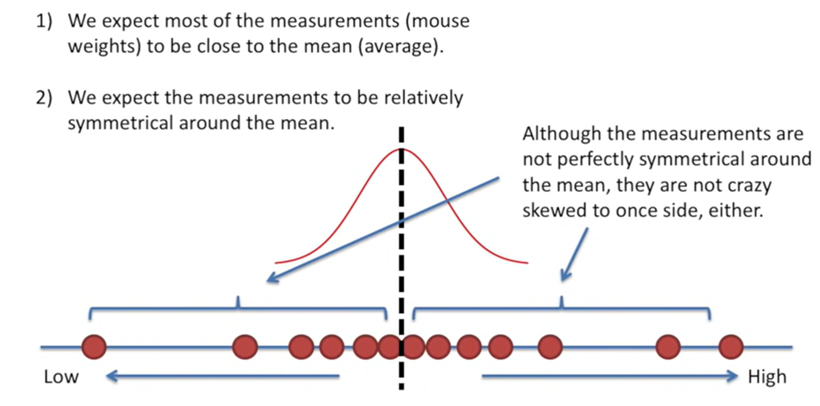
Normal Distribution:
Normal- values are normally distributed in this which means:

Slide 8
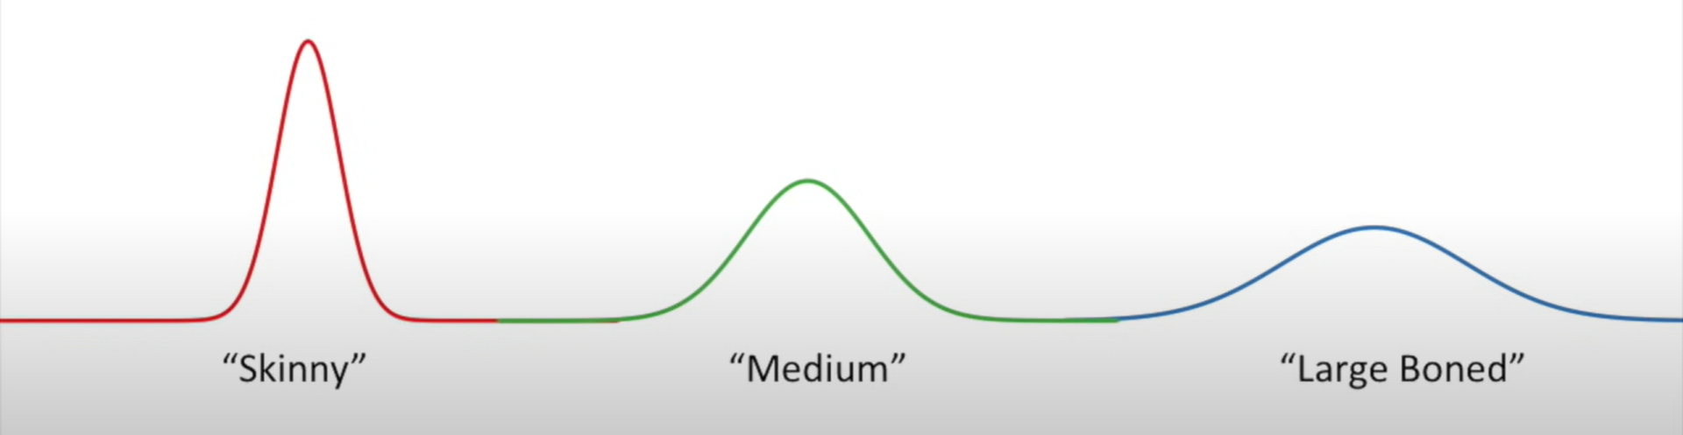
Normal distribution can be of any type:

Slide 9
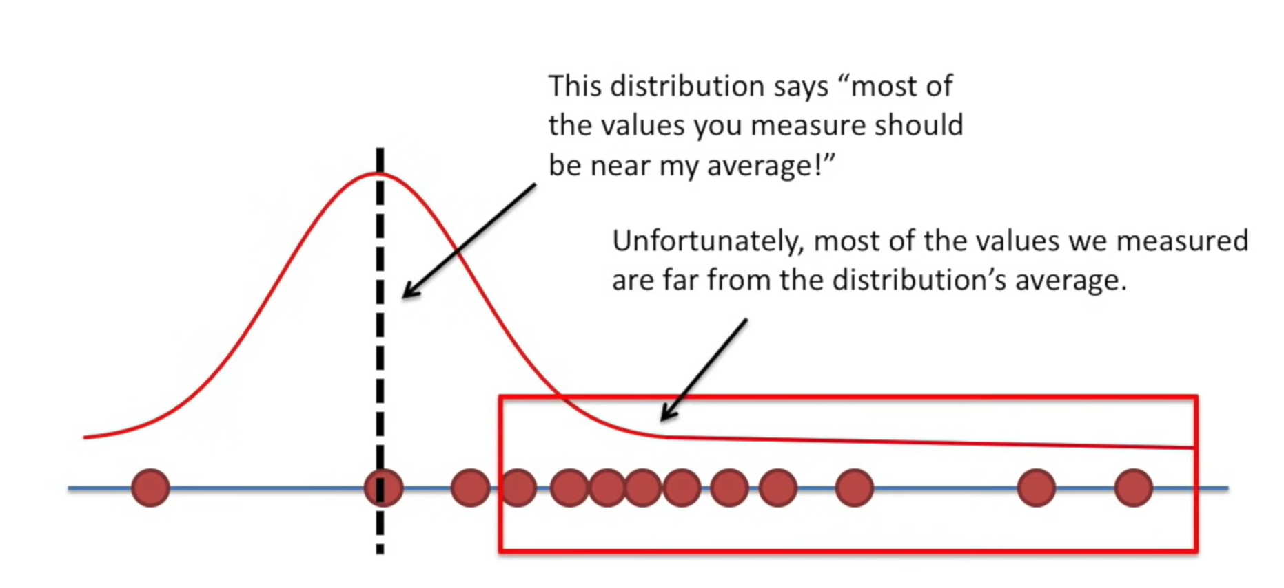

Slide 10
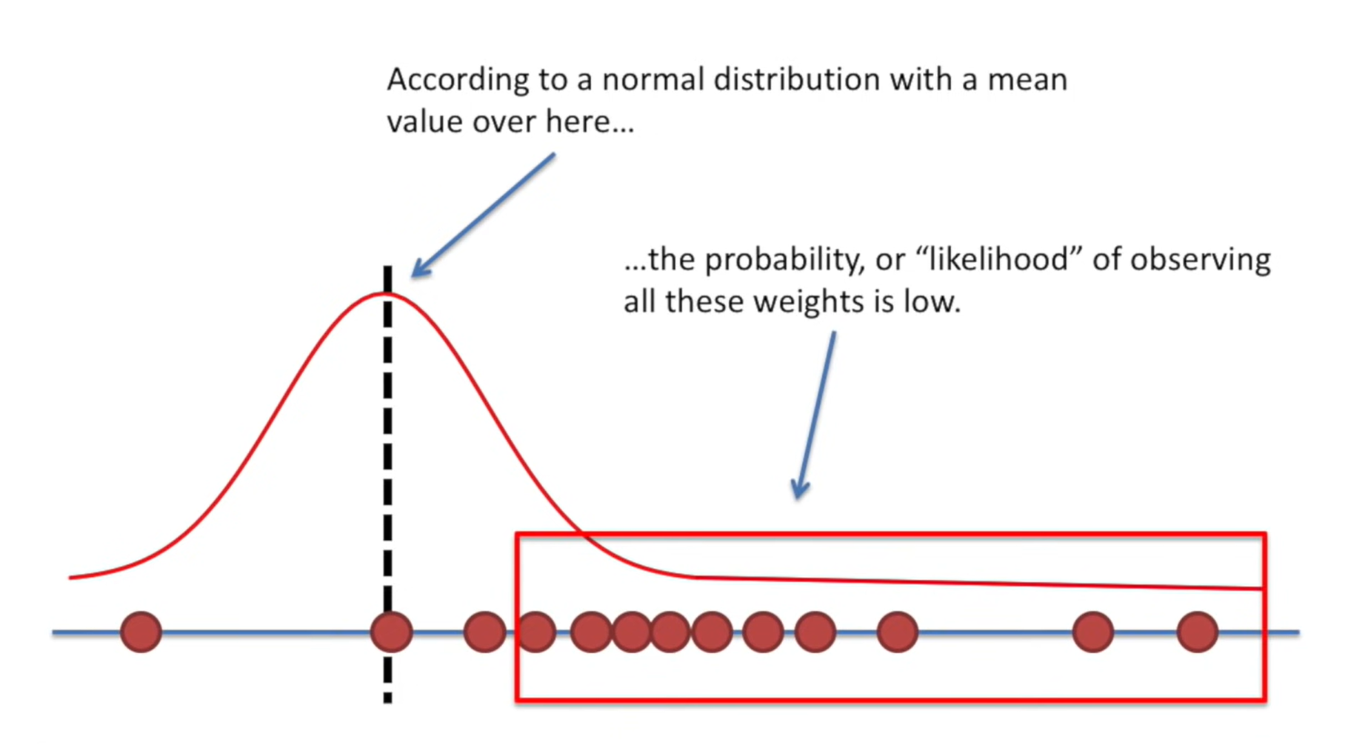

Slide 11
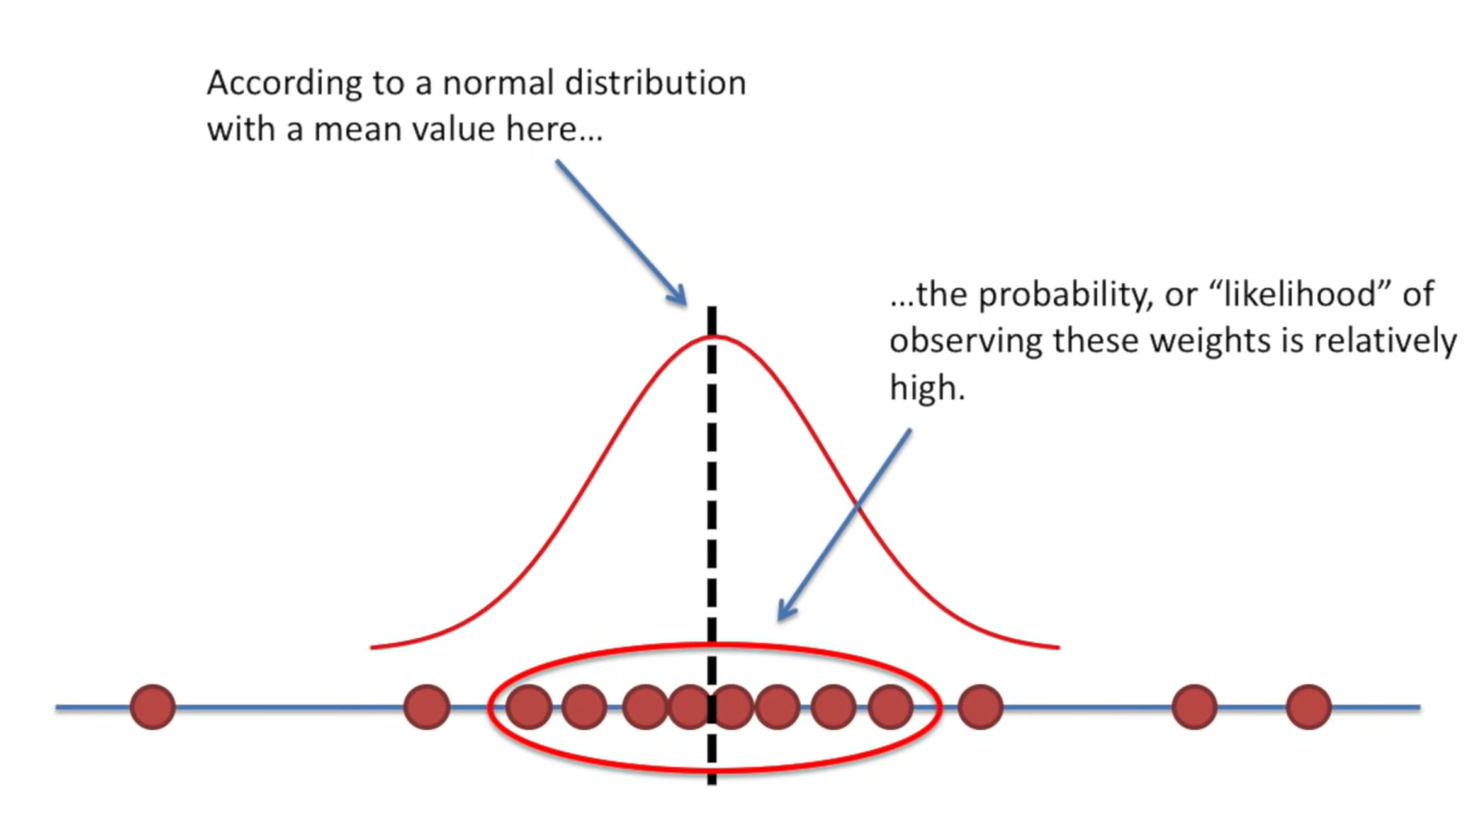

Slide 12
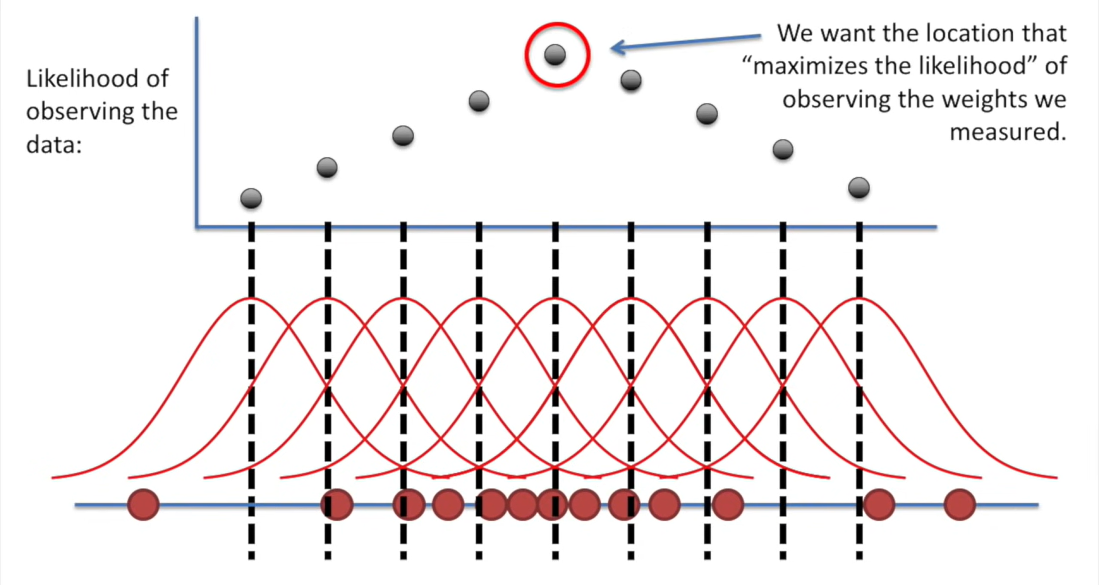
Let’s plot the mean:

Slide 13
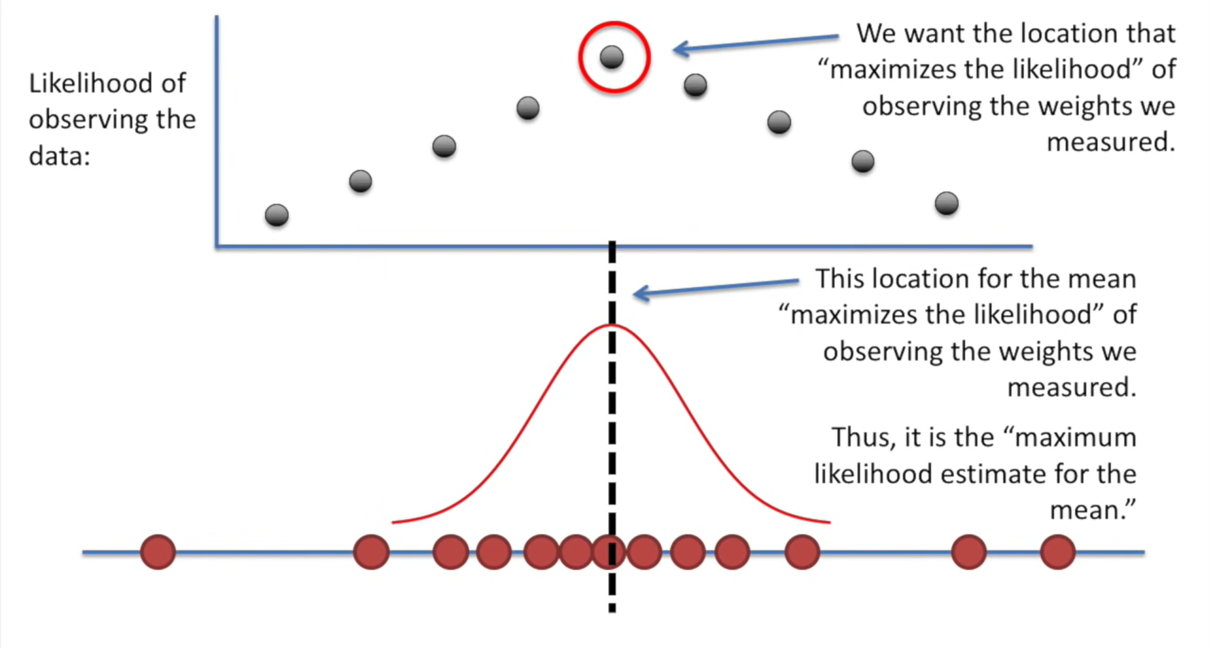

Slide 14
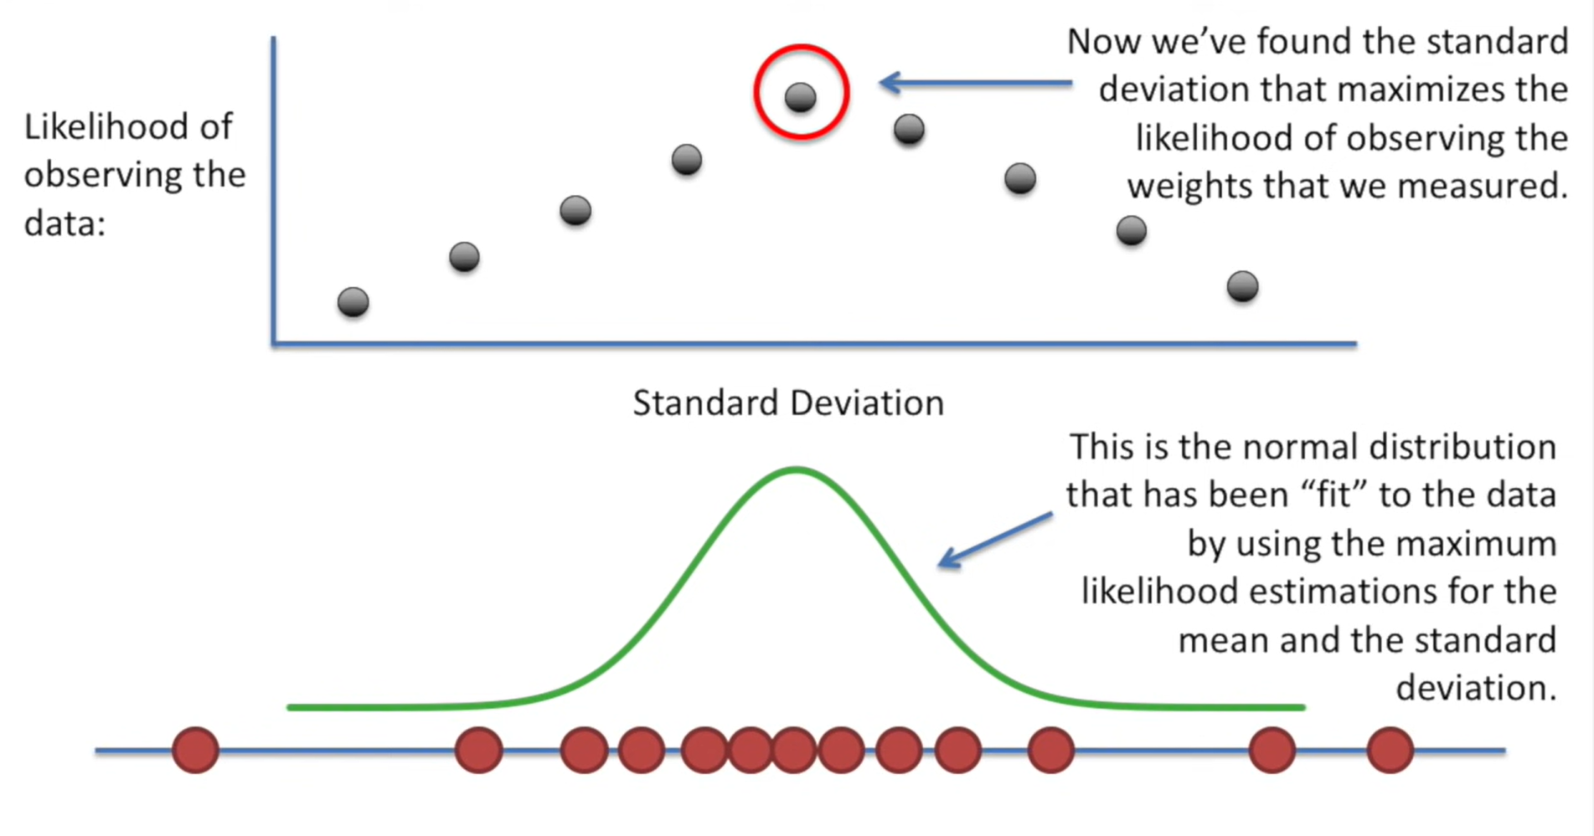
Instead of mean, if we are dealing with SD:

Slide 15
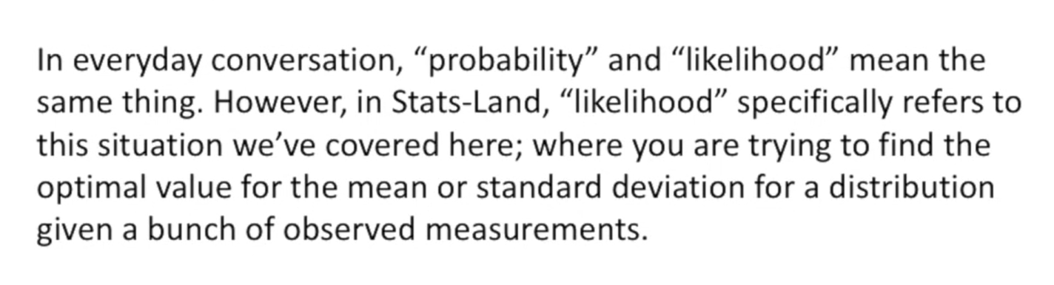

Slide 16
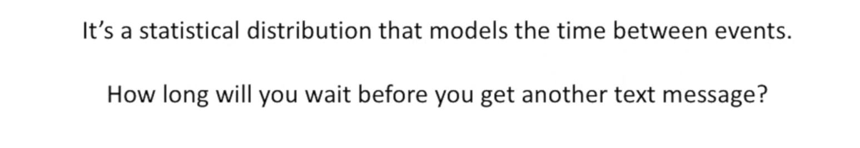
What is exponential distribution?

Slide 17
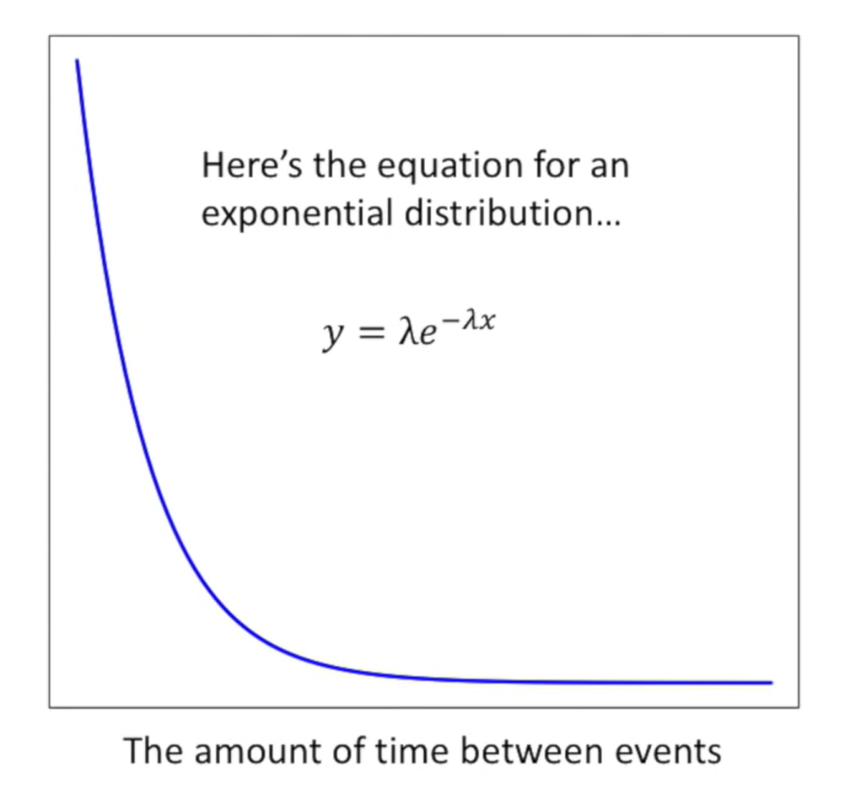
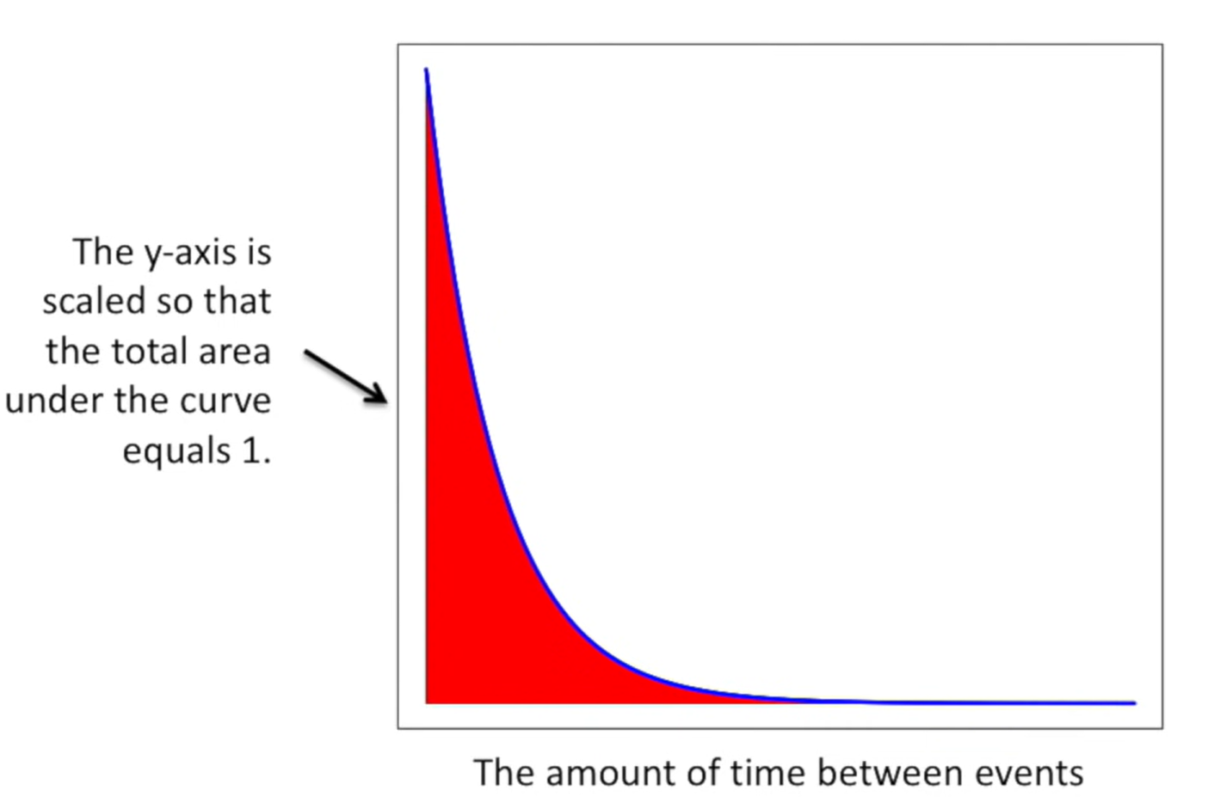

Slide 18
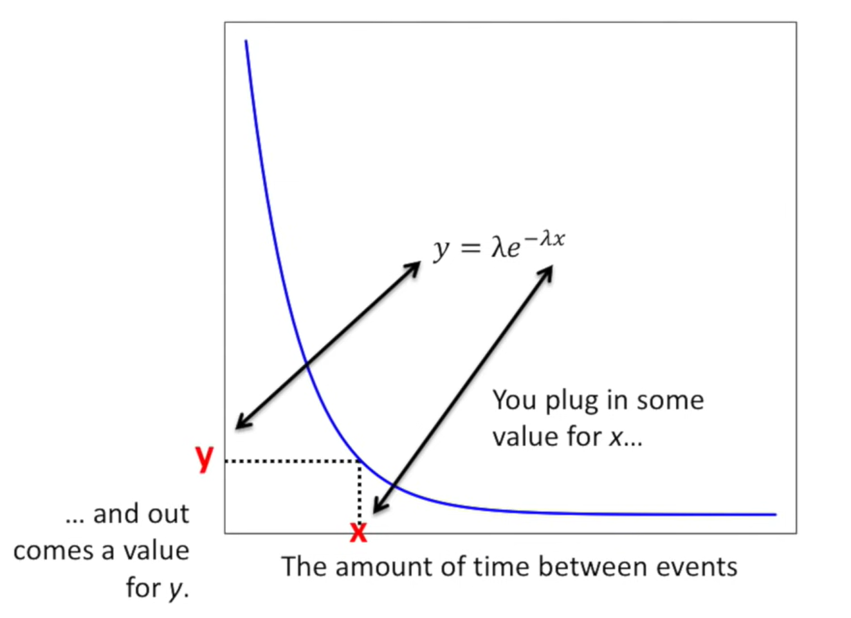
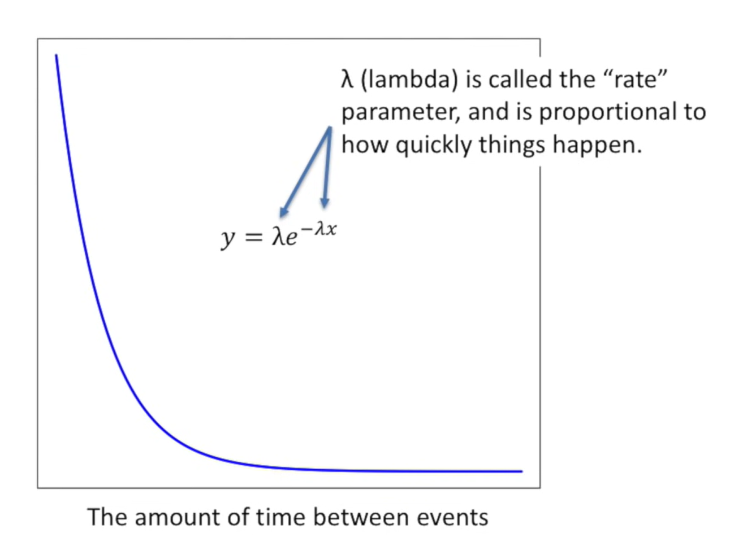

Slide 19
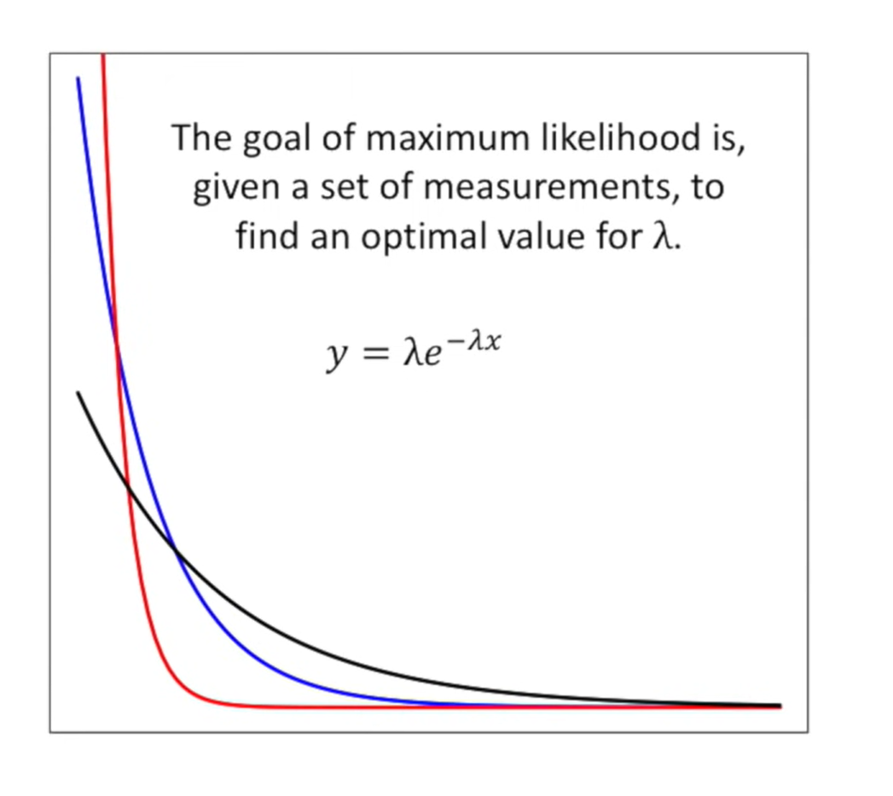

Slide 20
Assume that you have a lot data about how much time passed between message.
X1: the amount of time that passed between the 1st message and 2nd message.
X2: the amount of time that passed between the 2nd message and 3rd
message.
X3: the amount of time that passed between the 3rd message and 4th message.
And so on.

Slide 21
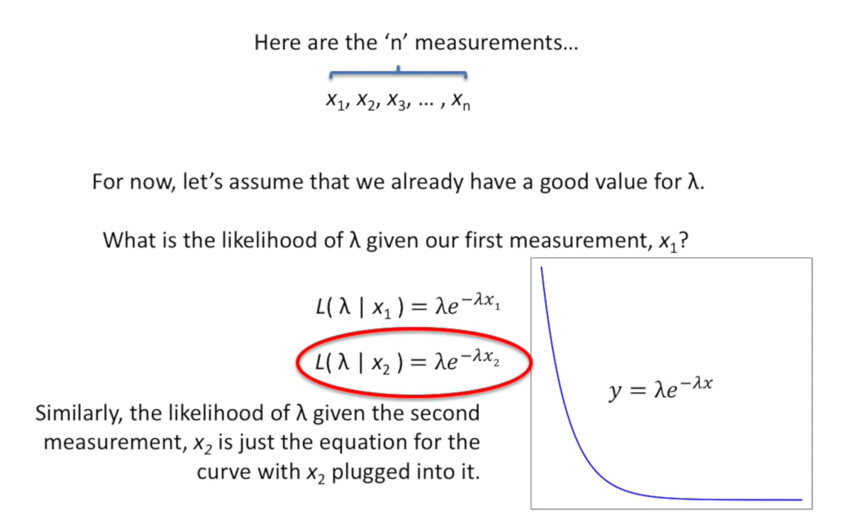

Slide 22
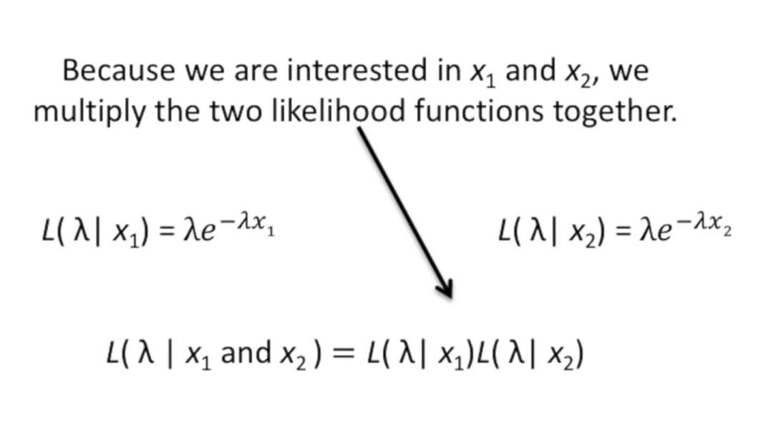
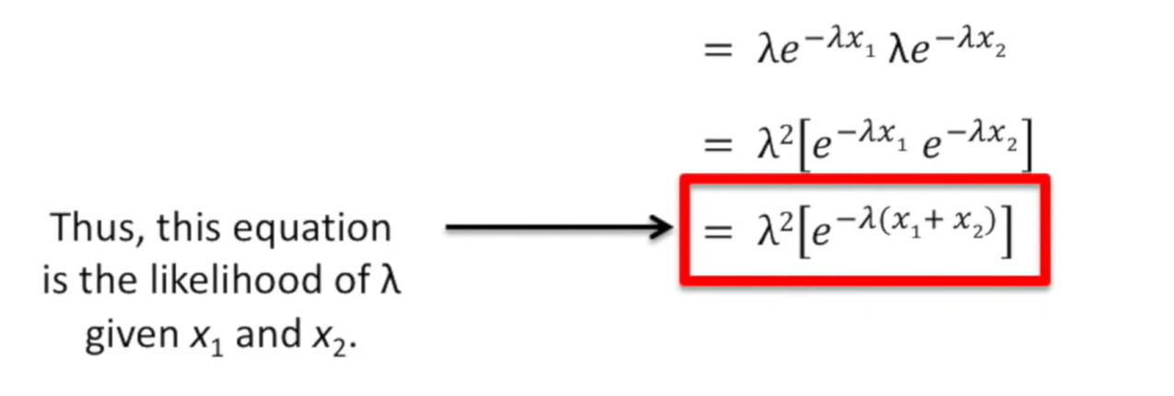

Slide 23
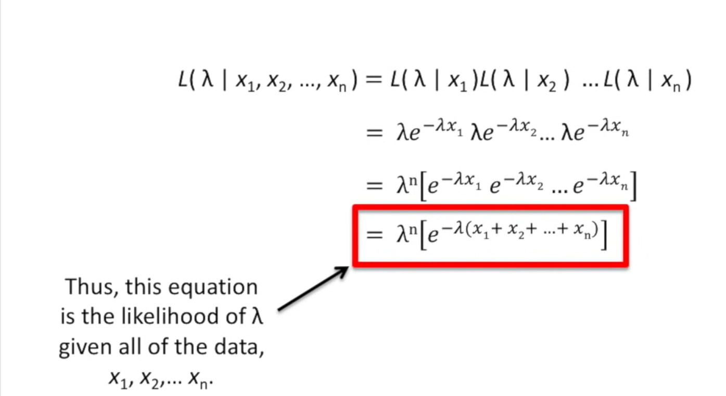
For x1 to xn

Slide 24
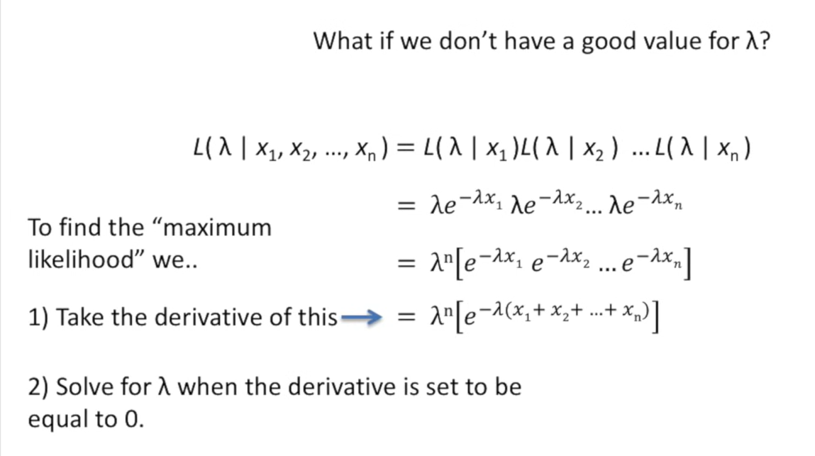
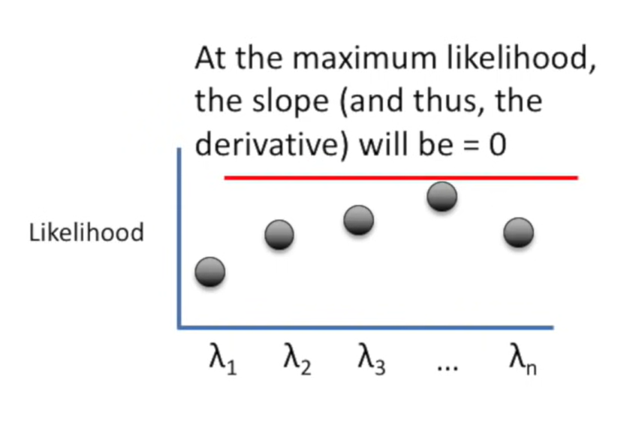

Slide 25
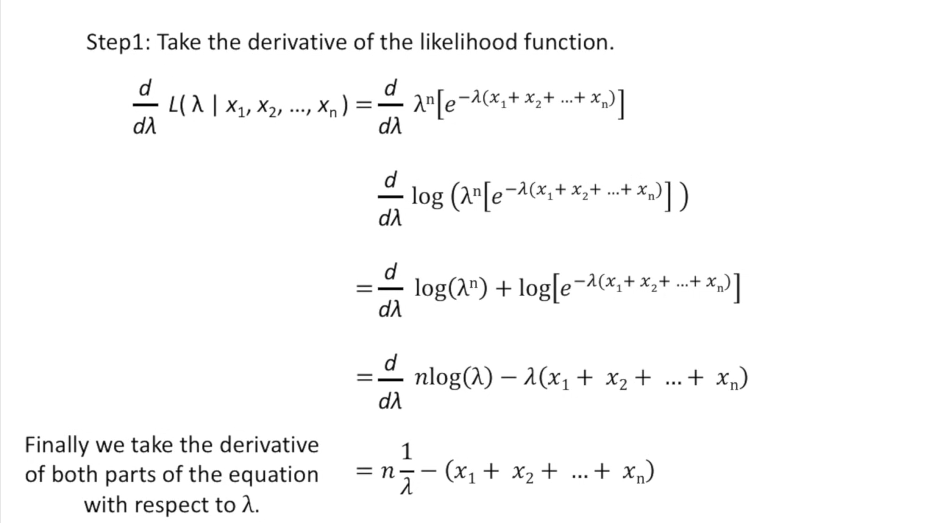

Slide 26
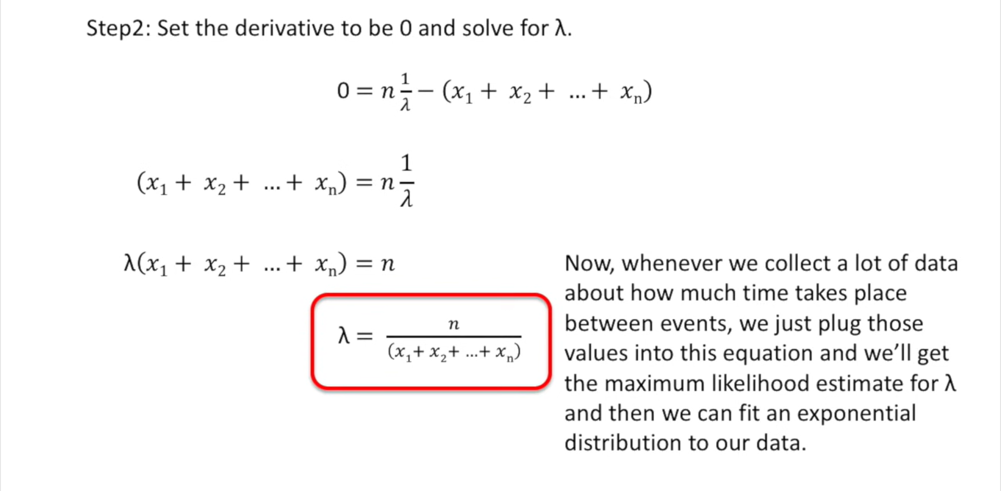

Slide 27
Bayesian learning:
Bayesian reasoning provides a probabilistic approach to inference.
Inference refers to the process of updating beliefs or making predictions about unknown quantities based on observed data and prior knowledge.
It is based on the assumption that the quantities of interest are governed by probability distributions and that optimal decisions can be made by reasoning about these probabilities together with observed data.
Bayesian learning methods are relevant to our study of machine learning for two different reasons.
Bayesian learning algorithms that calculate explicit probabilities for hypotheses, such as the naive Bayes classifier, are among the most practical approaches to certain types of learning problems.
they provide a useful perspective for understanding many learning algorithms that do not explicitly manipulate probabilities.

Slide 28
Features of Bayesian learning methods
Each observed training example can incrementally decrease or increase the estimated probability that a hypothesis is correct.
Prior knowledge can be combined with observed data to determine the final probability of a hypothesis.
Bayesian methods can accommodate hypotheses that make probabilistic predictions
New instances can be classified by combining the predictions of multiple hypotheses, weighted by their probabilities.
Even in cases where Bayesian methods prove computationally intractable, they can provide a standard of optimal decision making against which other practical methods can be measured.

Slide 29
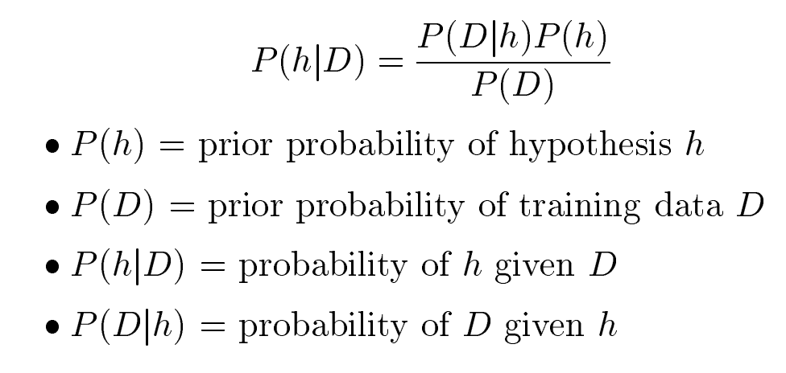
BAYES THEOREM
A prior probability is an initial probability value originally obtained before any additional information is obtained.
A posterior probability is a probability value that has been revised by using additional information that is later obtained.

Slide 30
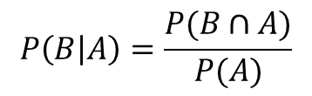
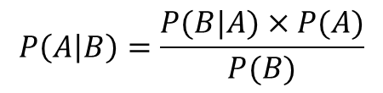
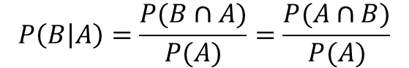
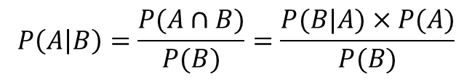
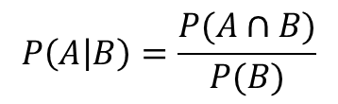
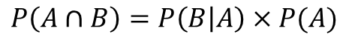
Derivation of Bayes’ theorem
Bayes’ theorem
$$P\left(A | B\right)=\frac{P(B|A)×P(A)}{P(B)}$$
$$P\left(A | B\right)=\frac{P(A∩B)}{P(B)}=\frac{P(B|A)×P(A)}{P(B)}$$
$$P\left(A | B\right)=\frac{P(A∩B)}{P(B)}$$
1
$$P\left(B | A\right)=\frac{P(B∩A)}{P(A)}$$
2
$$P\left(B | A\right)=\frac{P(B∩A)}{P(A)}=\frac{P(A∩B)}{P(A)}$$
$$P\left(A∩B\right)=P\left(B | A\right)×P(A)$$

Slide 31
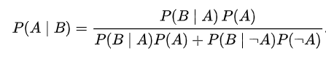
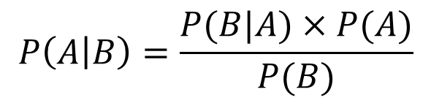
Bayes’ theorem, alternative form
$$P\left(A | B\right)=\frac{P(B|A)×P(A)}{P(B)}$$

Slide 32
Bayes’ theorem problems

Slide 33
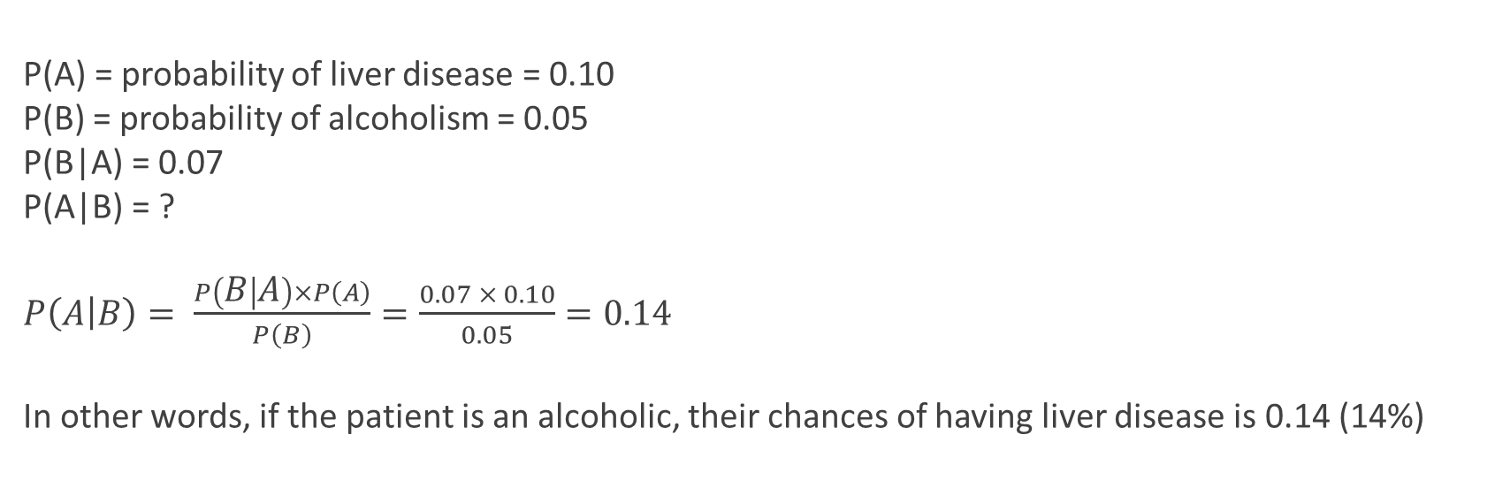
Example 1
10% of patients in a clinic have liver disease. Five percent of the clinic’s patients are alcoholics. Amongst those patients diagnosed with liver disease, 7% are alcoholics. You are interested in knowing the probability of a patient having liver disease, given that he is an alcoholic.
P(A) = probability of liver disease = 0.10
P(B) = probability of alcoholism = 0.05
P(B|A) = 0.07
P(A|B) = ?
$P\left(A | B\right)= \frac{P\left(B | A\right)×P\left(A\right)}{P\left(B\right)}=\frac{0.07 × 0.10}{0.05}=0.14$
In other words, if the patient is an alcoholic, their chances of having liver disease is 0.14 (14%)

Slide 34
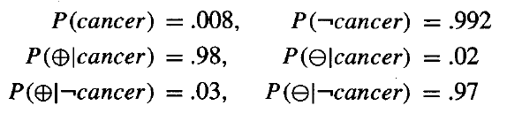
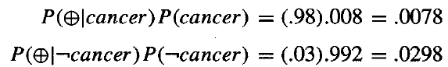
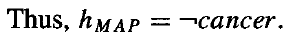

Example
We have prior knowledge that over the entire population of people only .008 have this disease. The test returns a correct positive result in only 98% of the cases in which the disease is actually present and a correct negative result in only 97% of the cases in which the disease is not present.
Suppose we now observe a new patient for whom the lab test returns a positive
result. Should we diagnose the patient as having cancer or not?

Slide 35
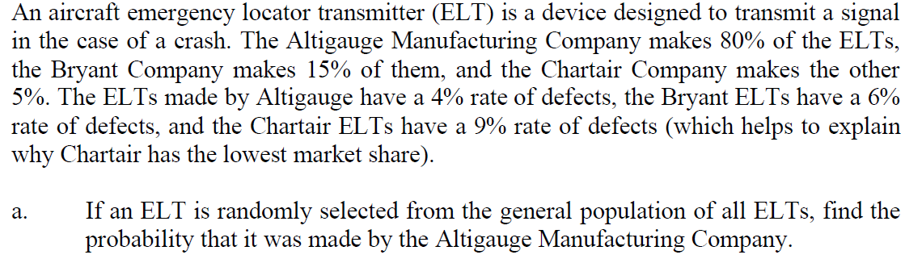
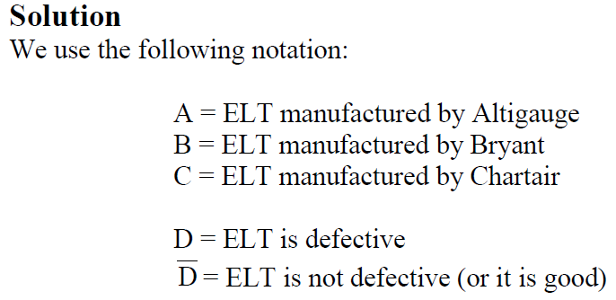
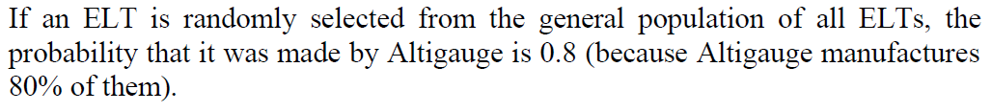
Example

Slide 36
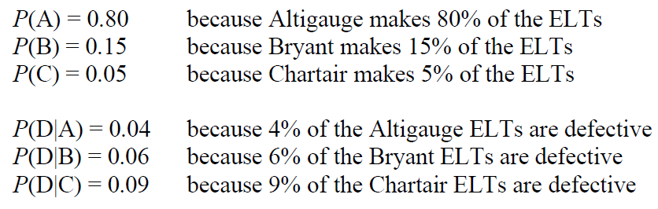
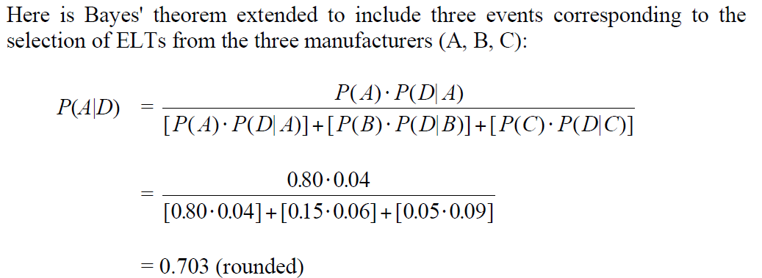

Slide 37
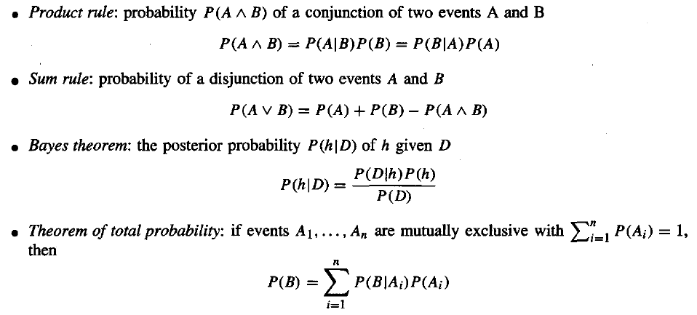
Basic Probability

Slide 38
BAYES THEOREM AND CONCEPT LEARNING
What is the relationship between Bayes theorem and the problem of concept learning?
Since Bayes theorem provides a principled way to calculate the posterior probability of each hypothesis given the training data, we can use it as the basis for a straightforward learning algorithm that calculates the probability for each possible hypothesis, then outputs the most probable.

Slide 39
Brute-Force Bayes Concept Learning
In particular, assume the learner considers some finite hypothesis space H defined over the instance space X, in which the task is to learn some target concept c : X → {0,1}.
As usual, we assume that the learner is given some sequence of training examples << x 1,d1 >. . . <xm, dm>> where xi is some instance from X and where di is the target value of xi (i.e., di = c(xi)).
To simplify the discussion in this section, we assume the sequence of instances (x1 . . . xm) is held fixed, so that the training data D can be written simply as the sequence of target values D = (d1 . . . dm)
We can design a straightforward concept learning algorithm to output the maximum a posteriori hypothesis, based on Bayes theorem, as follows:

Slide 40
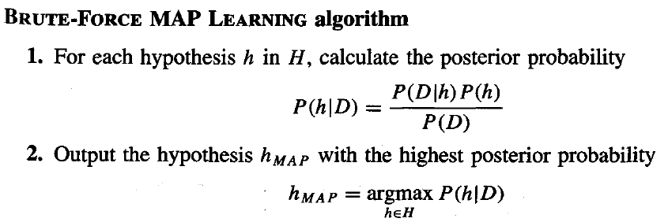
Lets consider following assumptions
1. The training data D is noise free (i.e., di = c(xi)).
2. The target concept c is contained in the hypothesis space H
3. We have no a priori reason to believe that any hypothesis is more probable than any other.
what values should we specify for P(h)?

Slide 41
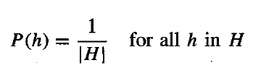
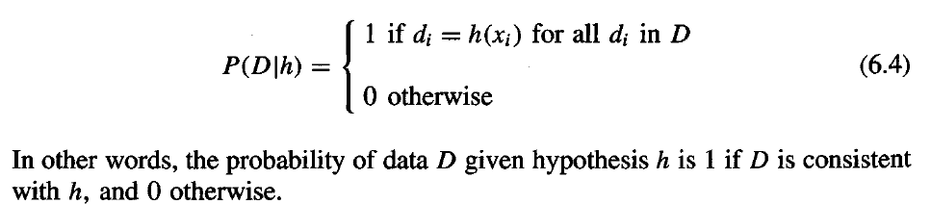
What choice shall we make for P(D/h)?
P(D/h) is the probability of observing the target values D = <d1 . . .dm> for the fixed set of instances <X1 . . . xm>, given a world in which hypothesis h holds

Slide 42
Bayes Optimal Classifier:
The Bayes Optimal Classifier is a theoretical concept in machine learning that represents the best possible classification algorithm given the underlying probability distribution of the data and a specified loss function. It's also known as the Bayes Optimal Decision Boundary or Bayes Optimal Classifier.
“Bayes Classifier: Probabilistic model that makes the most probable prediction for new examples.
The Bayes Optimal Classifier aims to minimize the expected risk, which is the average loss over all possible inputs, based on the true probability distribution of the data. The decision boundary of the Bayes Optimal Classifier is the one that minimizes the expected loss.

Slide 43
Gibbs Classifier
Bayes optimal classifier provides best result, but can be expensive if many hypotheses.
Gibbs algorithm:
1. Choose one hypothesis at random, according to P(h|D)
2. Use this to classify new instance
Surprising fact: assume target concepts are drawn at random from H according to priors on H. Then:
E[error_{Gibbs}] ≤ 2E[error_{BayesOptimal}]
Suppose correct, uniform prior distribution over H, then
Pick any hypothesis from VS, with uniform probability
Its expected error no worse than twice Bayes optimal

Slide 44
Naive Bayes Classifier:
Naive Bayes classifiers are a collection of classification algorithms based on Bayes’ Theorem. It is not a single algorithm but a family of algorithms where all of them share a common principle, i.e. every pair of features being classified is independent of each other.
One of the most simple and effective classification algorithms, the Naïve Bayes classifier aids in the rapid development of machine learning models with rapid prediction capabilities.
Why it is called Naive Bayes?
The “Naive” part of the name indicates the simplifying assumption made by the Naïve Bayes classifier. The classifier assumes that the features used to describe an observation are conditionally independent, given the class label.

Slide 45
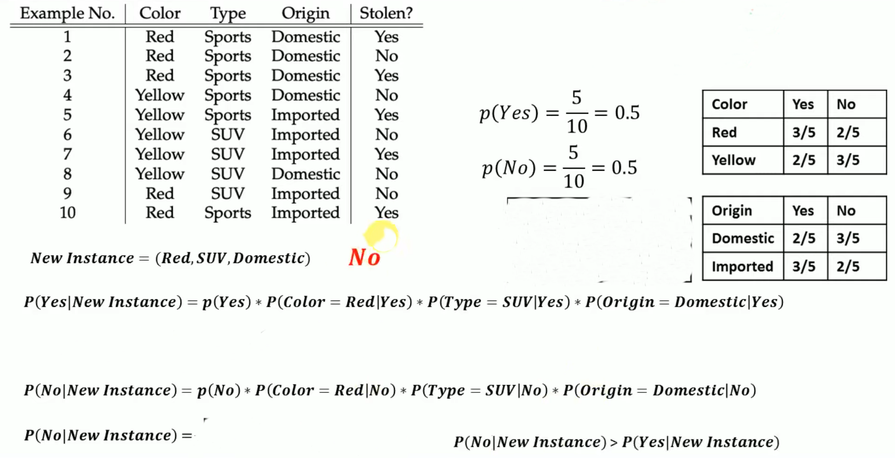
Example:
Type | Yes | No
Sports | 4/6 | 2/6
SUV | 1/4 | 3/4
0.5* (3/5)* (1/4)* (2/5)= 0.03
0.5* (2/5)* (3/4)* (3/5)= 0.09

Slide 46
EM Algorithm:
The Expectation-Maximization (EM) algorithm is an iterative optimization method that combines different unsupervised machine learning algorithms to find maximum likelihood or maximum posterior estimates of parameters in statistical models that involve unobserved latent variables. The EM algorithm is commonly used for latent variable models and can handle missing data. It consists of an estimation step (E-step) and a maximization step (M-step), forming an iterative process to improve model fit.
In the E step, the algorithm computes the latent variables i.e. expectation of the log-likelihood using the current parameter estimates.
In the M step, the algorithm determines the parameters that maximize the expected log-likelihood obtained in the E step, and corresponding model parameters are updated based on the estimated latent variables.

Slide 47
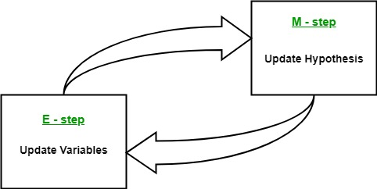
By iteratively repeating these steps, the EM algorithm seeks to maximize the likelihood of the observed data. It is commonly used for unsupervised learning tasks, such as clustering, where latent variables are inferred and has applications in various fields, including machine learning, computer vision, and natural language processing.

Slide 48
Latent Variables: Latent variables are unobserved variables in statistical models that can only be inferred indirectly through their effects on observable variables. They cannot be directly measured but can be detected by their impact on the observable variables.
Likelihood: It is the probability of observing the given data given the parameters of the model. In the EM algorithm, the goal is to find the parameters that maximize the likelihood.
Log-Likelihood: It is the logarithm of the likelihood function, which measures the goodness of fit between the observed data and the model. EM algorithm seeks to maximize the log-likelihood.
Maximum Likelihood Estimation (MLE): MLE is a method to estimate the parameters of a statistical model by finding the parameter values that maximize the likelihood function, which measures how well the model explains the observed data.
Posterior Probability: In the context of Bayesian inference, the EM algorithm can be extended to estimate the maximum a posteriori (MAP) estimates, where the posterior probability of the parameters is calculated based on the prior distribution and the likelihood function.
Expectation (E) Step: The E-step of the EM algorithm computes the expected value or posterior probability of the latent variables given the observed data and current parameter estimates. It involves calculating the probabilities of each latent variable for each data point.
Maximization (M) Step: The M-step of the EM algorithm updates the parameter estimates by maximizing the expected log-likelihood obtained from the E-step. It involves finding the parameter values that optimize the likelihood function, typically through numerical optimization methods.
Convergence: Convergence refers to the condition when the EM algorithm has reached a stable solution. It is typically determined by checking if the change in the log-likelihood or the parameter estimates falls below a predefined threshold.

Slide 49
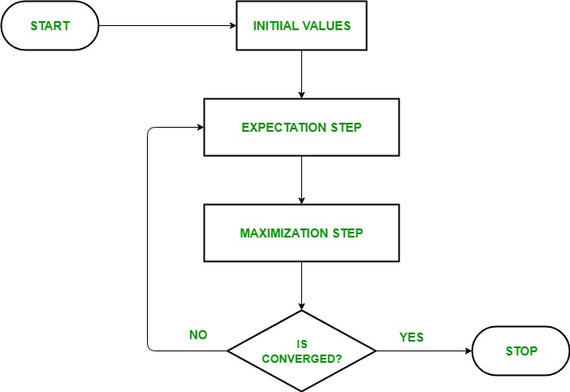
How Expectation-Maximization (EM) Algorithm Works:

Slide 50
Model evaluation and hyperparameter tuning

Slide 51
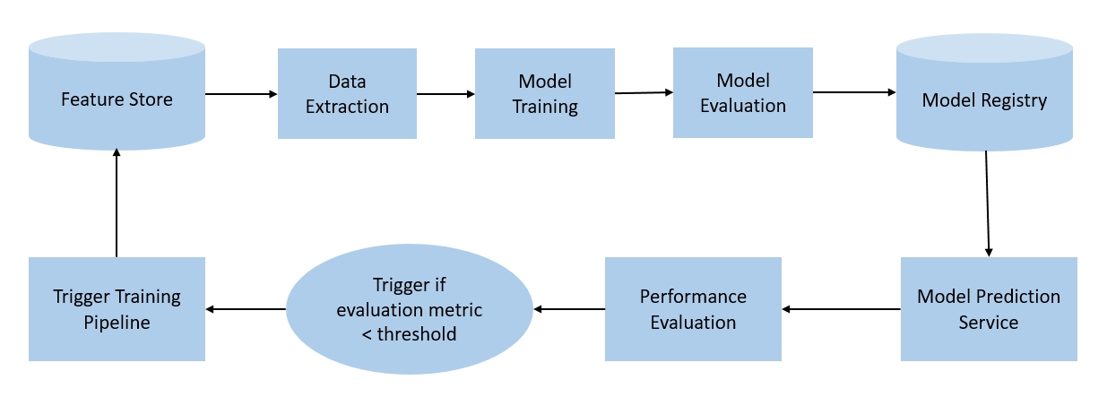

Streamlining Workflows with Pipelines:

Slide 52
A typical ML pipeline includes the following stages:
Data Ingestion/Collection:
Each ML pipeline starts with the Data ingestion step. In this step, the data is processed into a well-organized format, which could be suitable to apply for further steps. This step does not perform any feature engineering; rather, this may perform the versioning of the input data.
Data Validation
The next step is data validation, which is required to perform before training a new model. Data validation focuses on statistics of the new data, e.g., range, number of categories, distribution of categories, etc. In this step, data scientists can detect if any anomaly present in the data. There are various data validation tools that enable us to compare different datasets to detect anomalies.
Data Pre-processing
Data pre-processing is one of the most crucial steps for each ML lifecycle as well as the pipeline. We cannot directly input the collected data to train the model without pr-processing it, as it may generate an abrupt result.
Model Training & Tuning
The model training step is the core of each ML pipeline. In this step, the model is trained to take the input (pre-processed dataset) and predicts an output with the highest possible accuracy.

Slide 53
Model Analysis
After model training, we need to determine the optimal set of parameters by using the loss of accuracy metrics. Apart from this, an in-depth analysis of the model's performance is crucial for the final version of the model. The in-depth analysis includes calculating other metrics such as precision, recall, AUC, etc. This will also help us in determining the dependency of the model on features used in training and explore how the model's predictions would change if we altered the features of a single training example.
Model Versioning
The model versioning step keeps track of which model, set of hyperparameters, and datasets have been selected as the next version to be deployed. For various situations, there could occur a significant difference in model performance just by applying more/better training data and without changing any model parameter. Hence, it is important to document all inputs into a new model version and track them.
7. Model Deployment
After training and analyzing the model, it's time to deploy the model. An ML model can be deployed in three ways, which are:
Using the Model server,
In a Browser
On Edge device
However, the common way to deploy the model is using a model server. Model servers allow to host multiple versions simultaneously, which helps to run A/B tests on models and can provide valuable feedback for model improvement.

Slide 54
Using kfold Cross Validation to Access Model Performance
Cross Validation: The aim of Cross-Validation is to use it as a tool to evaluate machine learning models, by training a number of models on different subsets of the input data.
Cross-validation can be used to detect overfitting in a model which infers that the model is not effectively generalizing patterns and similarities in the new inputted data.

Slide 55
Workflow of cross validation:
In order to perform cross-validation, the following steps are typically taken:
Split the dataset into training data and test data
The parameters will undergo a Cross-Validation test to see which are the best parameters to select.
These parameters will then be implemented into the model for retraining
Final evaluation will occur and this will depend if the cycle has to go again, depending on the accuracy and the level of generalization that the model performs.
There are different types of Cross-Validation techniques:
Hold-out- The holdout method is the simplest kind of cross validation. The data set is separated into two sets, called the training set and the testing set.
K-folds
Leave-one-out
Leave-p-out

Slide 56
K-fold Cross-Validation:
K-fold Cross-Validation is when the dataset is split into a K number of folds and is used to evaluate the model's ability when given new data. K refers to the number of groups the data sample is split into. For example, if you see that the k-value is 5, we can call this a 5-fold cross-validation. Each fold is used as a testing set at one point in the process.

Slide 57
K-fold Cross-Validation Process:
Choose your k-value
Split the dataset into the number of k folds.
Start off with using your k-1 fold as the test dataset and the remaining folds as the training dataset
Train the model on the training dataset and validate it on the test dataset
Save the validation score
Repeat steps 3 – 5, but changing the value of your k test dataset. So we chose k-1 as our test dataset for the first round, we then move onto k-2 as the test dataset for the next round.
By the end of it you would have validated the model on every fold that you have.
Average the results that were produced in step 5 to summarize the skill of the model.

Slide 58
K-Fold Cross-validation
 Create a K-fold partition of the the dataset
■ For each of K experiments, use K-1 folds for training and a different fold for testing
 This procedure is illustrated in the following figure for K=4
Total number of examples
Experiment 1
Experiment 2
Experiment 3
Test examples
Experiment 4
 K-Fold Cross validation is similar to Random Subsampling
■ The advantage of K-Fold Cross validation is that all the examples in the dataset are eventually used for both training and testing
 As before, the true error is estimated as the average error rate on test examples
1
K
K
E =
∑ i
E
i=1
6

Slide 59
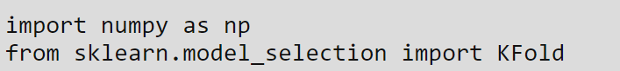
For using KFold cross validation:

Slide 60
Leave-one-out Cross Validation
 Leave-one-out is the degenerate case of K-Fold Cross Validation, where K is chosen as the total number of examples
■ For a dataset with N examples, perform N experiments
■ For each experiment use N-1 examples for training and the remaining example for testing
Total number of examples
Experiment 1
Experiment 2
Experiment 3
Single test example
Experiment N
 As usual, the true error is estimated as the average error rate on test examples
1
N
N
E =
∑ i
E
i=1

Slide 61

Leave-p-out: p number reflect number of test set in single iteration

Slide 62
Debugging Algorithms with Learning and Validation Curves:
The best way to gain insight into the performance of a model is through plotting learning curves.
Learning curves plot a key evaluation metric against the iteration number, to see how it changes as the model is training. The metric is typically either cost or accuracy - although the metrics may differ based on your problem - for example a skewed dataset may use the F1 score instead.

Slide 63


Slide 64
Important points about learning curves:
If a model has high bias, it is said to underfit the data. This is when the model doesn’t have the capacity to learn a complex enough representation of the data - so has a high error in the prediction (high bias).
A model with high bias will have high training and validation set error - if the learning curve plateaus early with a high error, use a more complex model. Typically neural networks don’t suffer from this issue, although if this is the case it is worth increasing the number of hidden layers, or number of hidden units in each layer.
If the model has high variance, we say that it is overfitting the data.
High variance hampers the model’s ability to generalise since rather than learning a more general, robust representation, it has instead learnt a representation very specific to that particular set of input data.
A model with high variance typically has a low training set error but a high validation error when the learning curves are plotted.

Slide 65
A Validation Curve is an important diagnostic tool that shows the sensitivity between changes in a Machine Learning model’s accuracy with changes in hyperparameters of the model.
The validation curve plots the model performance metric (such as accuracy, F1-score, or mean squared error) on the y-axis and a range of hyperparameter values on the x-axis. The hyperparameter values of the models are typically varied on a logarithmic scale, and the model is trained and evaluated using a cross-validation technique for each hyperparameter value.
Two curves are present in a validation curve – one for the training set score and one for the cross-validation score. By default, the function for validation curve, present in the scikit-learn library performs 3-fold cross-validation. A validation curve is used to evaluate an existing model based on hyper-parameters and is not used to tune a model. This is because, if we tune the model according to the validation score, the model may be biased towards the specific data against which the model is tuned; thereby, not being a good estimate of the generalization of the model.

Slide 66
Interpreting a Validation Curve:
Interpreting the results of a validation curve can sometimes be tricky. Keep the following points in mind while looking at a validation curve :
Ideally, we would want both the validation curve and the training curve to look as similar as possible.
If both scores are low, the model is likely to be underfitting. This means either the model is too simple or it is informed by too few features. It could also be the case that the model is regularized too much.
If the training curve reaches a high score relatively quickly and the validation curve is lagging behind, the model is overfitting. This means the model is very complex and there is too little data, or it could simply mean there is too little data.
We would want the value of the parameter where the training and validation curves are closest to each other

Slide 67
Fine-Tuning Machine Learning Models via Grid Search:
A model hyperparameter is a characteristic of a model that is external to the model and whose value cannot be estimated from data. The value of the hyperparameter has to be set before the learning process begins. For example, c in Support Vector Machines, k in k-Nearest Neighbors, the number of hidden layers in Neural Networks.
or
In the context of machine learning, hyperparameters are configuration variables that are set before the training process of a model begins. They control the learning process itself, rather than being learned from the data. Hyperparameters are often used to tune the performance of a model, and they can have a significant impact on the model’s accuracy, generalization, and other metrics.
Fine tuning is a machine-learning technique that involves making small adjustments to a pre-trained model to improve its performance on a specific task.

Slide 68
Grid Search:
Grid search can be considered as a “brute force” approach to hyperparameter optimization.
Grid Search uses a different combination of all the specified hyperparameters and their values and calculates the performance for each combination and selects the best value for the hyperparameters. This makes the processing time-consuming and expensive based on the number of hyperparameters involved.

Slide 69


Slide 70

How to Apply GridSearchCV?
.GridSearchCV() method is available in the scikit-learn class model_selection. It can be initiated by creating an object of GridSearchCV():
Primarily, it takes 4 arguments i.e. estimator, param_grid, cv, and scoring. The description of the arguments is as follows:
1. estimator – A scikit-learn model
2. param_grid – A dictionary with parameter names as keys and lists of parameter values.
3. scoring – The performance measure. For example, ‘r2’ for regression models, ‘precision’ for classification models.
4. cv – An integer that is the number of folds for K-fold cross-validation.

Slide 71
Thank you!

